Slide 1
Highlights of Chinese OC missions
Xianqiang He
State Key Laboratory of
Satellite Ocean Environment Dynamics (SOED)
Second Institute of oceanography(SIO),
State Oceanic Administration(SOA), China

Slide 2
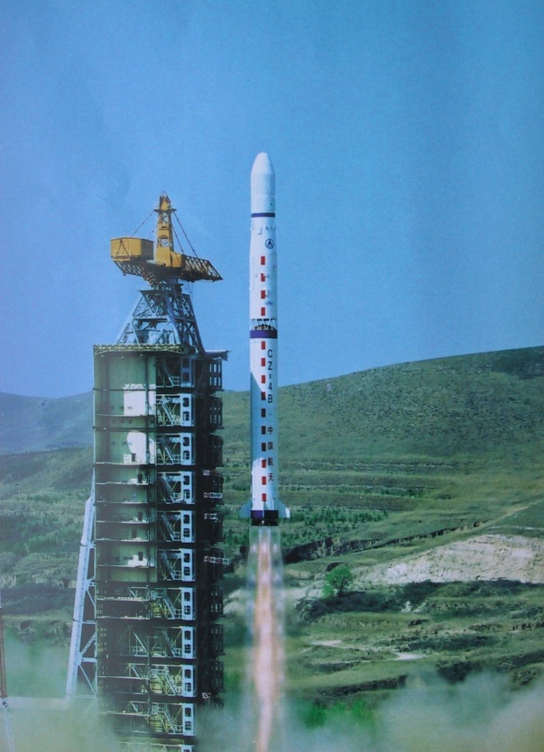
Long-term space program plan of China (2015~2025)
~70 earth observing satellites will be launched during 2015~2025.
Three kinds of satellite missions:
(1) Oceanic Satellites
(2) Meteorological Satellites
(3) Land and Environment Satellites

Slide 3
Four series of Chinese ocean (HY) satellite missions
(15-17 satellites to be launched before 2025 )
2002 2007 2009 2012 2014 2016 2018
HY-1A
HY-1B
HY-1C
HY-1D
HY-1 series
Ocean color
HY-1E
HY-1F
HY-2A
HY-2 series
Ocean dynamic
HY-2B
HY-3 series
HY-3A
Ocean high spatial resolution monitoring
HY-4 series
HY-4
Geostationary, high temporal resolution monitoring
End
Manufact.
On obits
Going on
Notes:
3
3

Slide 4
Chinese ocean color and temperature scanner (COCTS)
Sensor | HY-1A/COCTS | HY-1B/COCTS
Spatial resolution | 1.1km | 1.1km
Scan coverage | 1400km | 3000km
Digitization | 10bit/pixel | 10bit/pixel
Band | Wavelength (μm) | Referred radiance（µW/cm²µmsr） | SNR | Saturated radiance （µW/cm2µmsr）
1 | 0.402～0.422 | 9.10 | 349 | 13.94
2 | 0.433～0.453 | 8.41 | 472 | 14.49
3 | 0.480～0.500 | 6.56 | 467 | 14.59
4 | 0.510～0.530 | 5.46 | 448 | 13.86
5 | 0.555～0.575 | 4.57 | 417 | 13.89
6 | 0.660～0.680 | 2.46 | 309 | 11.95
7 | 0.740～0.760 | 1.61 | 200 | 5.0/9.72
8 | 0.845～0.885 | 1.09 | 327 | 3.5/6.93
9 | 10.30～11.40 | 0.2K(300K, NEΔT) |  | 200-320K
10 | 11.40～12.50 | 0.2K(300K, NEΔT) |  | 200-320K

Slide 5
HY-1B/COCTS monthly products
Chl_a
TSM
SST

Slide 6
HY-1B/COCTS global monthly SST

Slide 7
Comparison between HY-1C/D and HY-1B
 | Properties | HY-1B | HY-1C/D
Satellite platform | Tilt observing capacity | No | ±20º
 | Global observing | partly | Yes
COCTS | On orbit calibration | No | Yes
CZI | Band width | 20nm | 80nm
 | Spatial resolution | 250m | 50m
 | Swath width | 500km | 950km
UICS (Ultraviolet imager) | Bands |  | 2 (355nm,385nm)
 | Spatial resolution |  | 550km
 | Swath width |  | 3000km
 | SNR |  | >1000

Slide 8
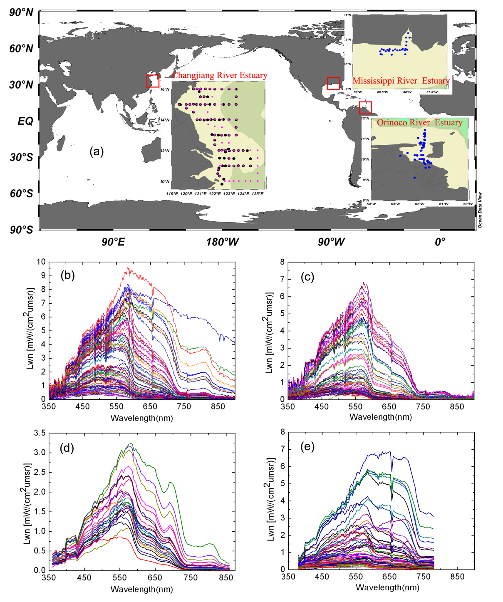
Turbid water atmospheric correction using UV band
In turbid waters, water-leaving radiance at UV may be negligible as compared to it at VIS or even NIR.
Using UV band to estimate aerosol scattering radiance instead of the traditional near-infrared bands.
Spring, Changjiang Estuary
Autumn, Changjiang Estuary
Mississippi Estuary
Orinoco Estuary
412nm
745nm
865nm
He et al., OE, 2012

Slide 9
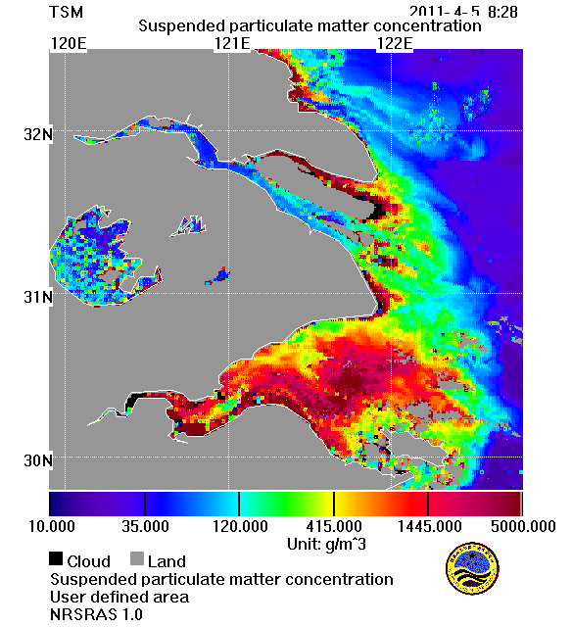
UV-AC derived hourly TSM from GOCI
5 Apr., 2011
He et al., RSE, 2013

Slide 10
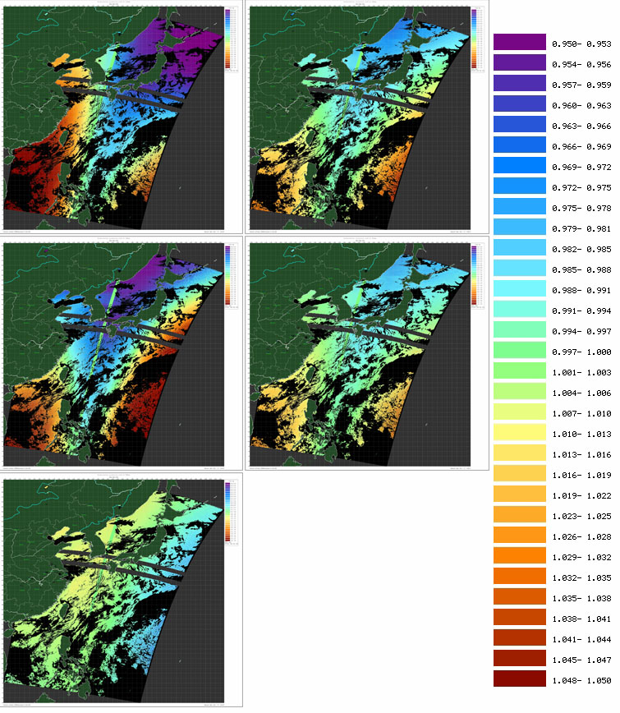
On-orbit estimation of polarization sensitivity
Exact radiance estimated by cross-calibration using SeaWiFS
Sensor measured radiance
He et al., IEE-TGRS, 2016

Slide 11
Four series of Chinese ocean (HY) satellite missions
(15-17 satellites to be launched before 2025 )
2002 2007 2009 2012 2014 2016 2018
HY-1A
HY-1B
HY-1C
HY-1D
HY-1 series
Ocean color
HY-1E
HY-1F
HY-2A
HY-2 series
Ocean dynamic
HY-2B
HY-3 series
HY-3A
Ocean high spatial resolution monitoring
HY-4 series
HY-4
Geostationary, high temporal resolution monitoring
End
Manufact.
On obits
Going on
Notes:
11
11

Slide 12
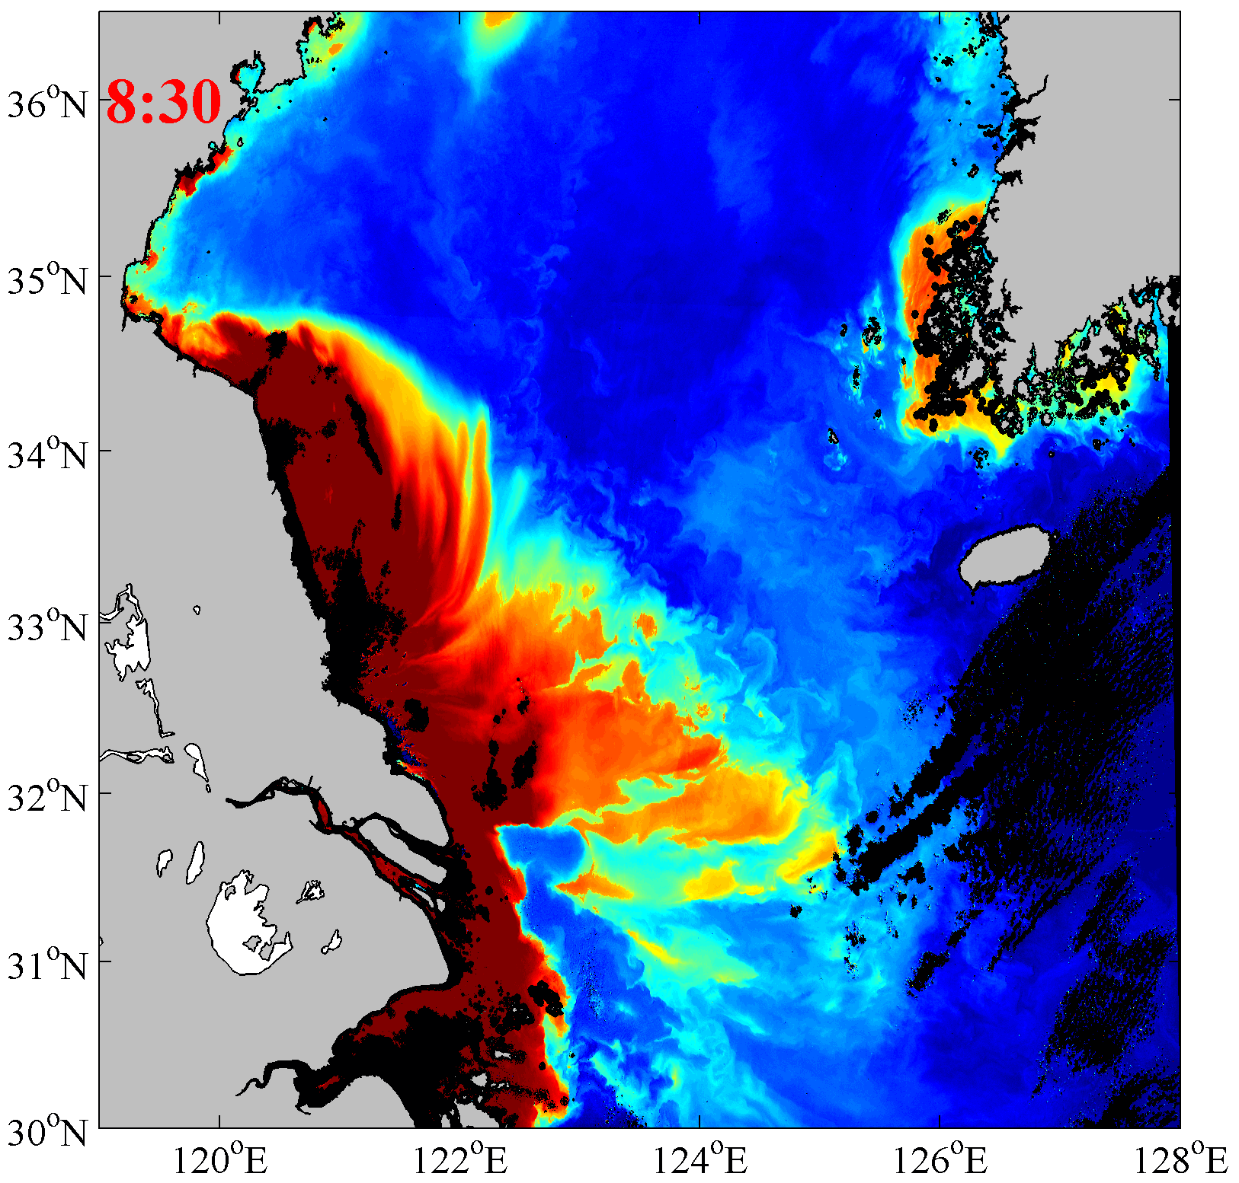
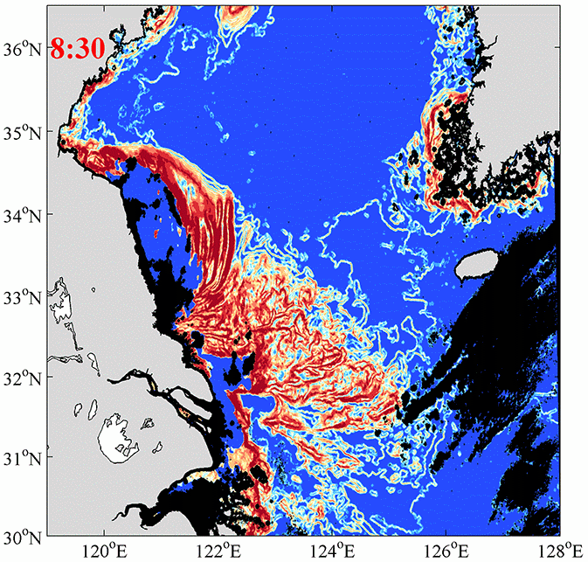
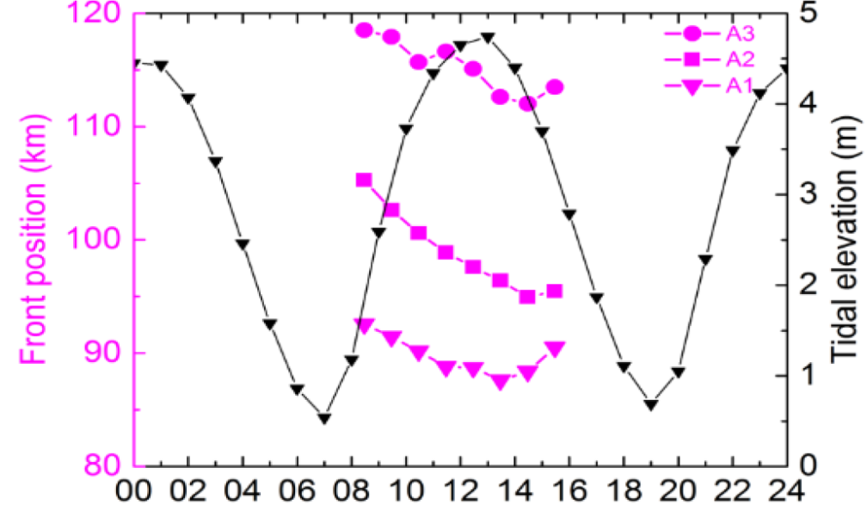
Diurnal Variability of Turbidity Fronts Observed by Geostationary Ocean Color Remote Sensing
2011-04-05
entropy-based algorithm
Diurnal displacement of turbidity fronts can be up to 10.3 km
Hu, Pan and He* et al., Remote Sensing, 2016

Slide 13
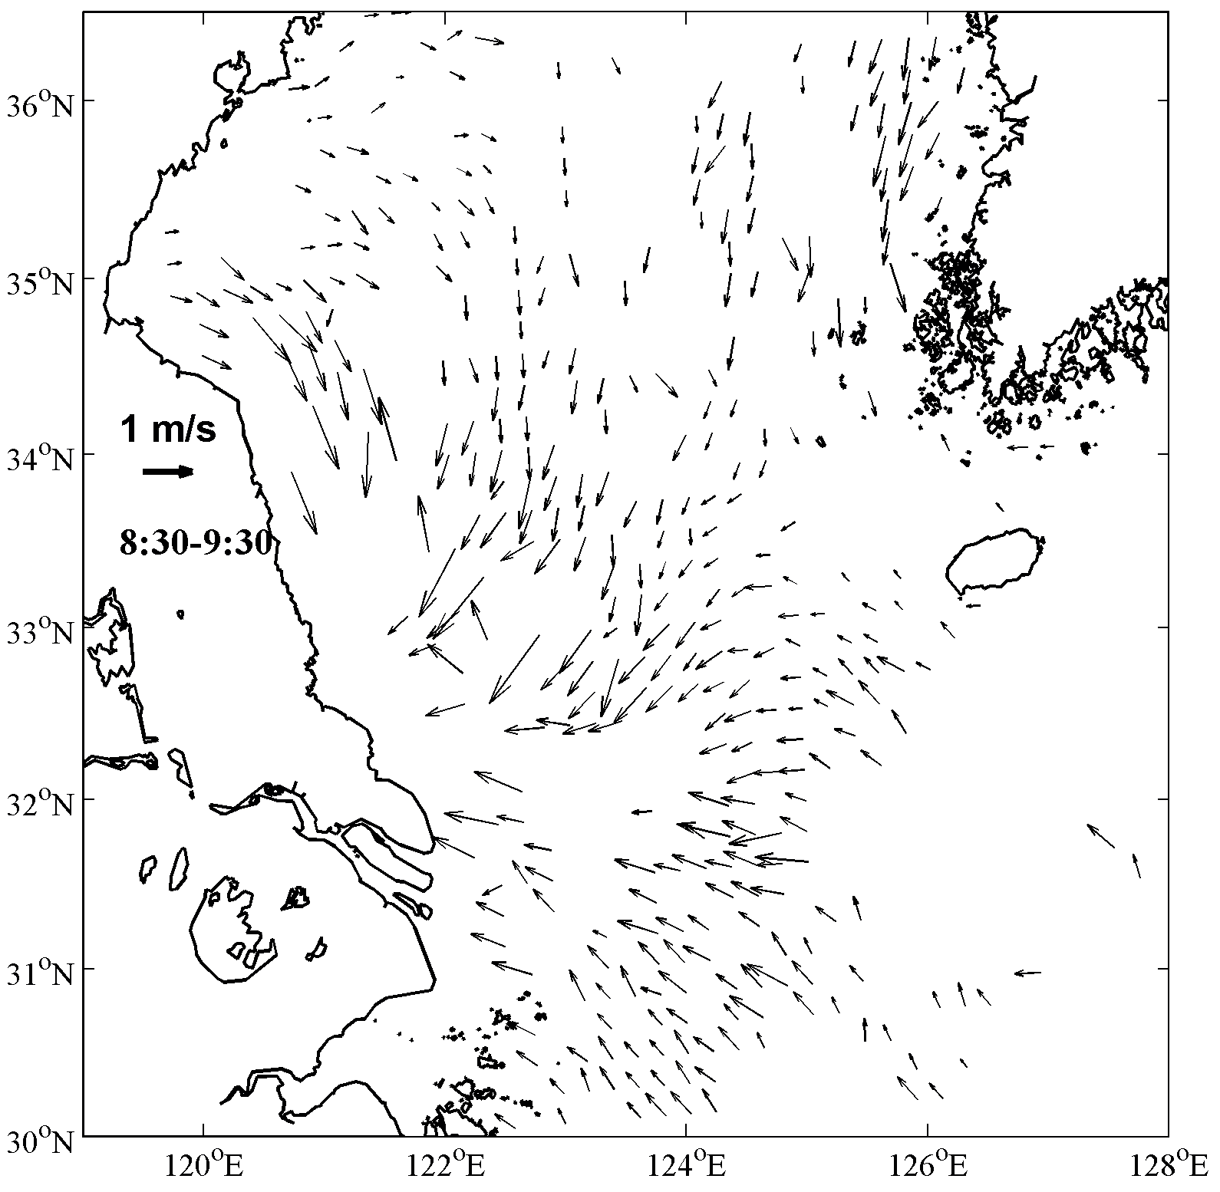
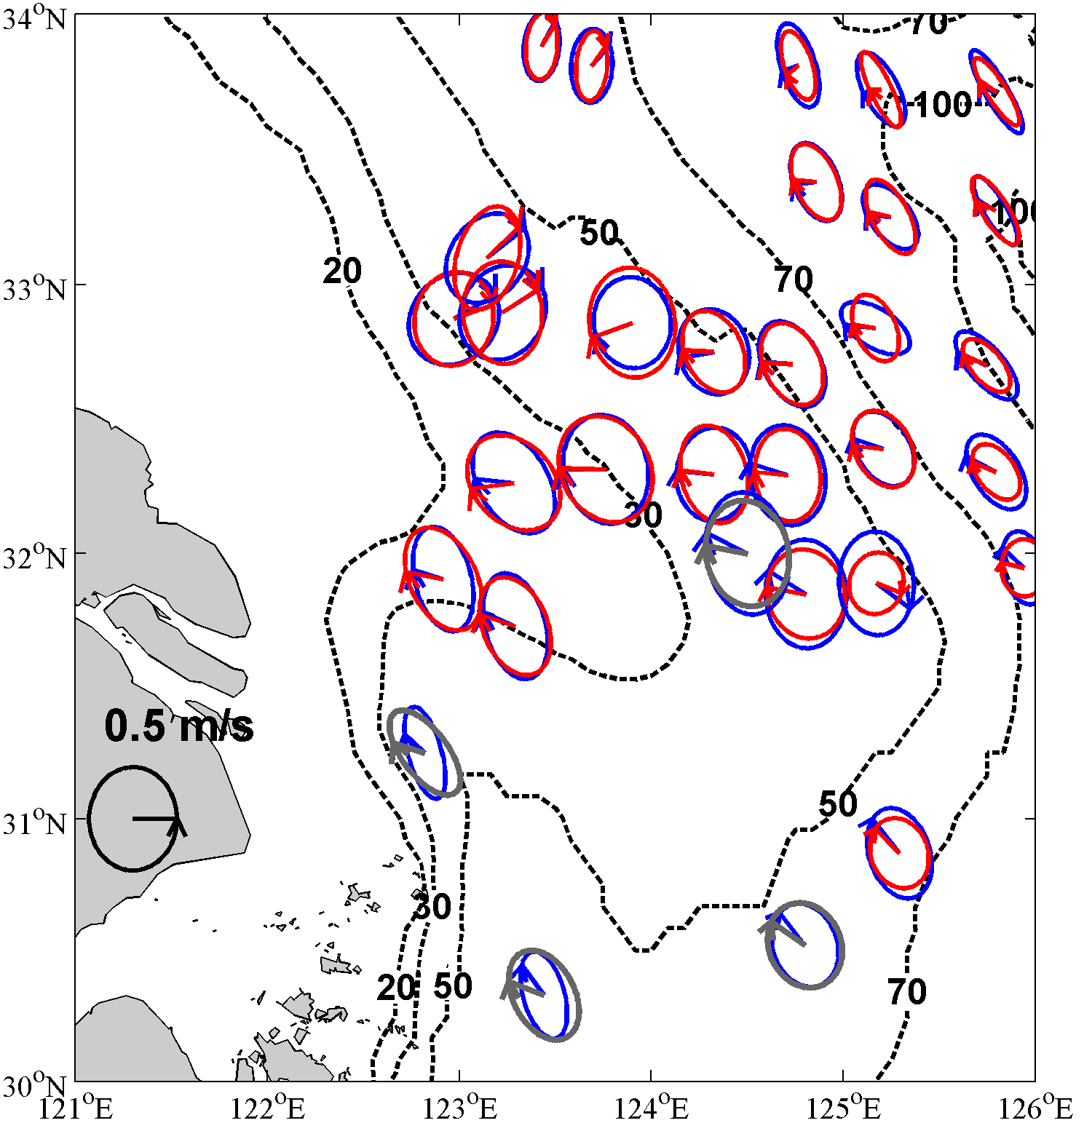
Mapping tidal currents by geostationary OC satellite
Satellite-derived current
Tidal current
Satellite
In situ
Hu et al., JGR-Oceans, 2016

Slide 14
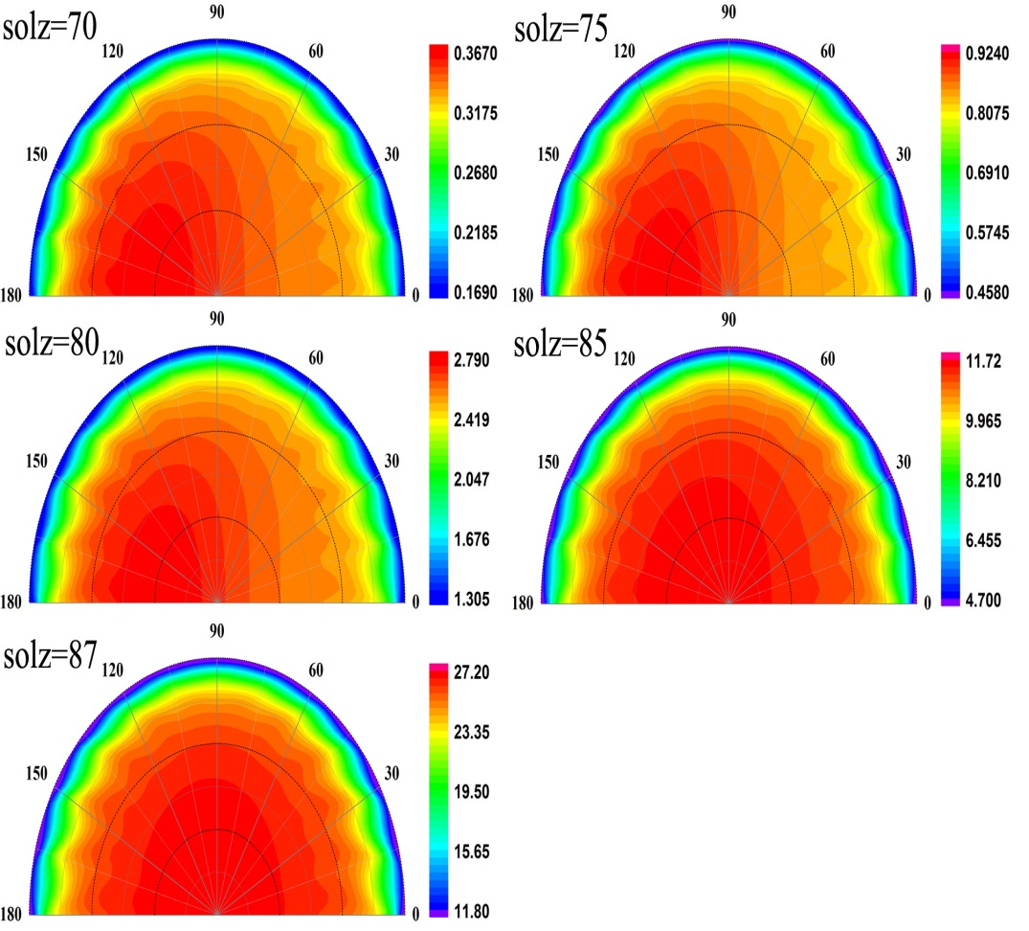
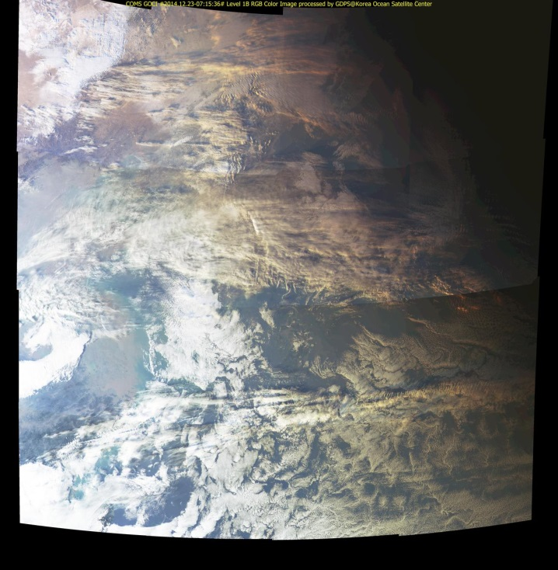
Develop the vector radiative transfer model for spherical atmosphere (PCOART-SA)
PCOART-SA is the vector RT model for coupled ocean-atmosphere system with considering Earth curvature, based on the PCOART (He et al., JQRST, 2010)
2014-12-23 15:30
(Local time)
RE=(SP-PP)*100%/SP
He et al., In preparation

Slide 15
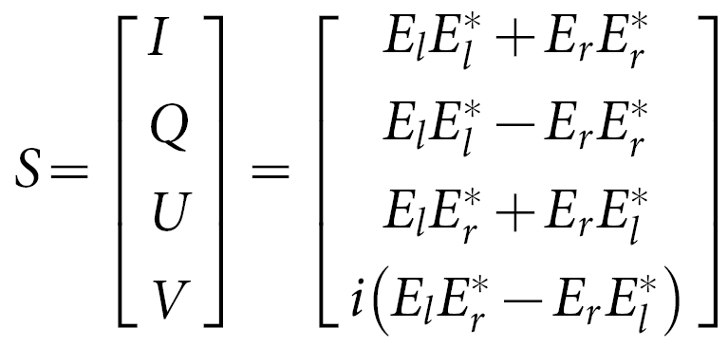
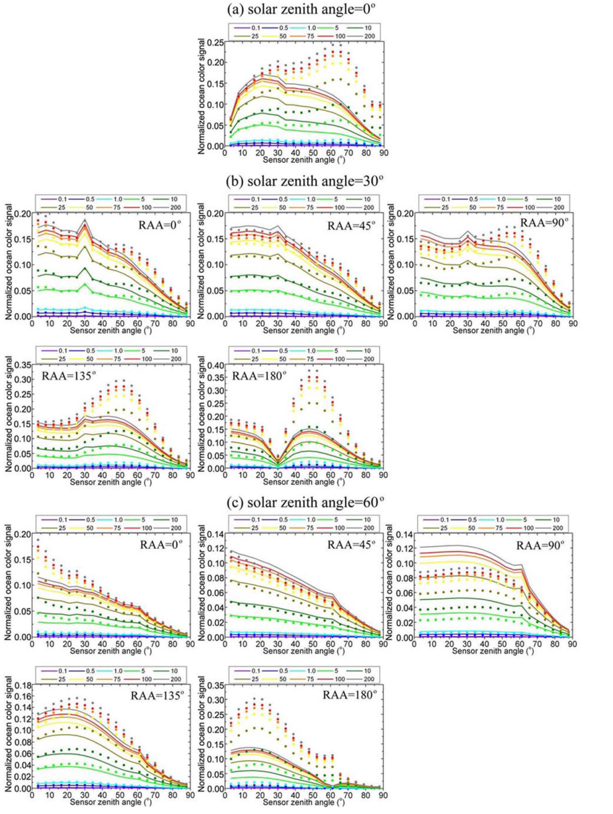
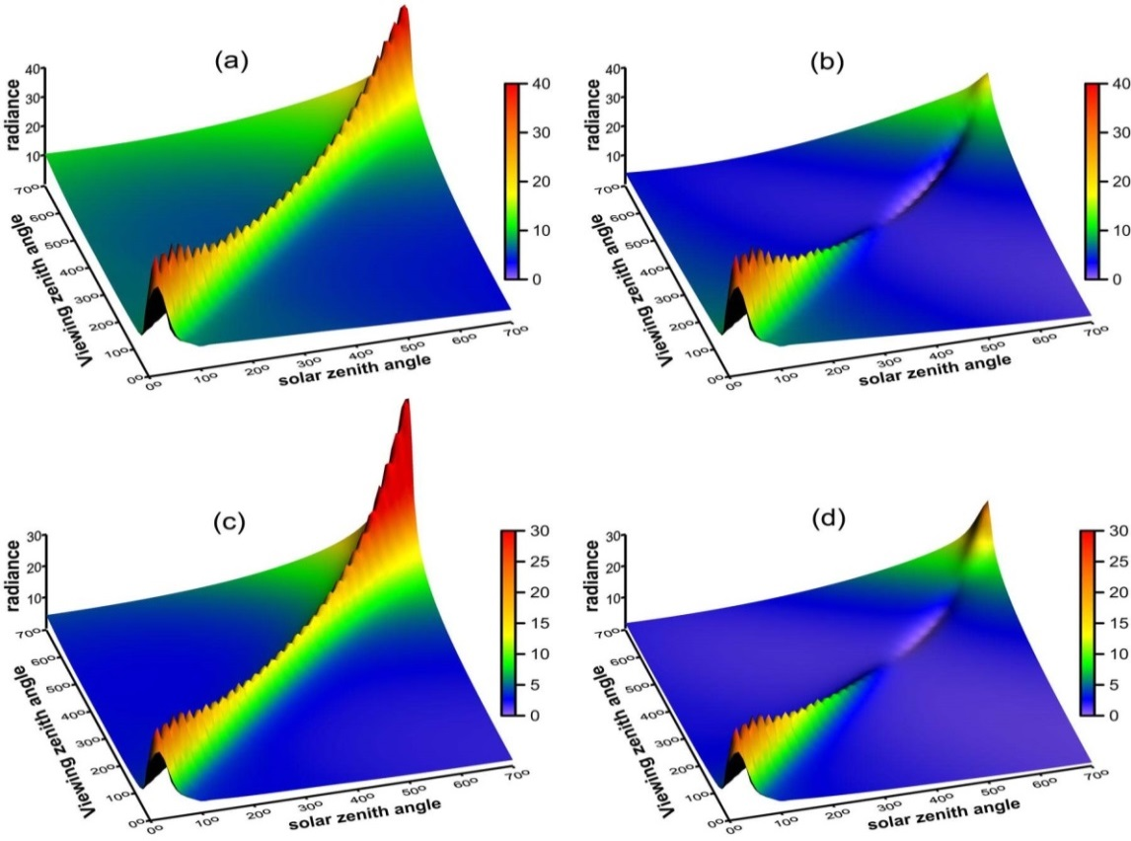
A new concept for OC remote sensing using parallel polarization radiance
Enhance signal-to-noise ratio
Diminish sun glint
I (443nm)
Ip(443nm)
I (670nm)
Ip (670nm)
He et al., Scientific Reports, 2014

Slide 16
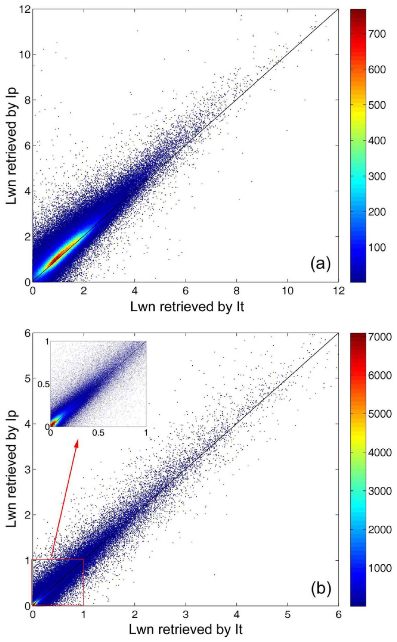
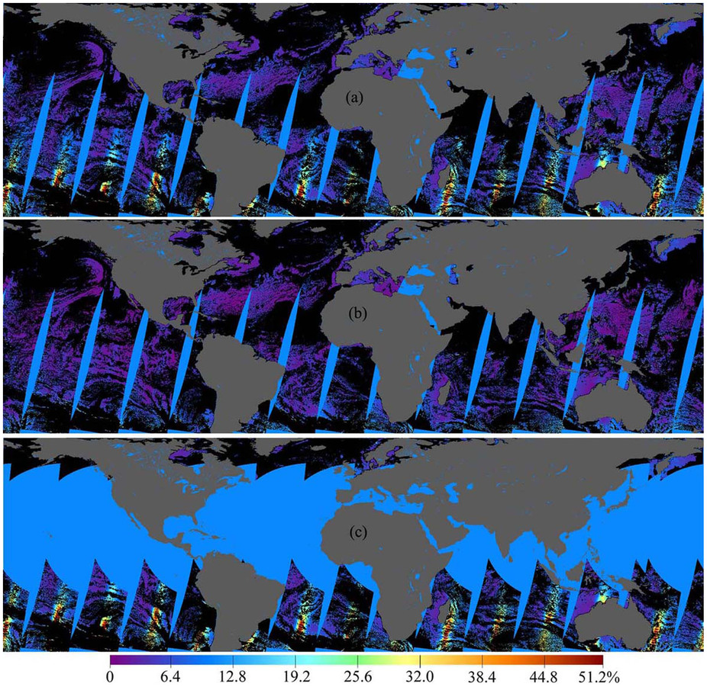
Concept validation by POLDER observation
POLDER (2003-7-10)
I(670)
Ip(670)
Reflectance
He et al., Scientific Reports, 2014

Slide 17
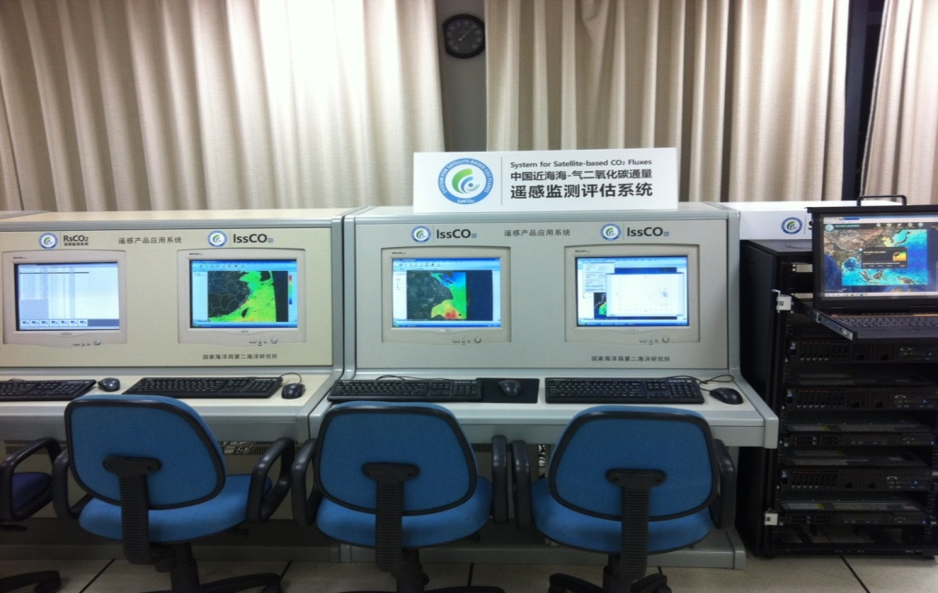
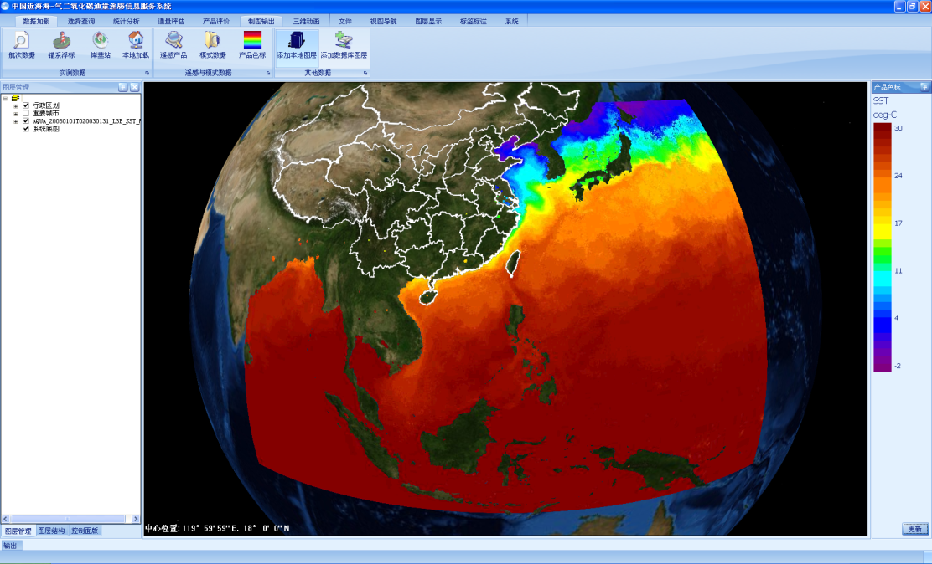
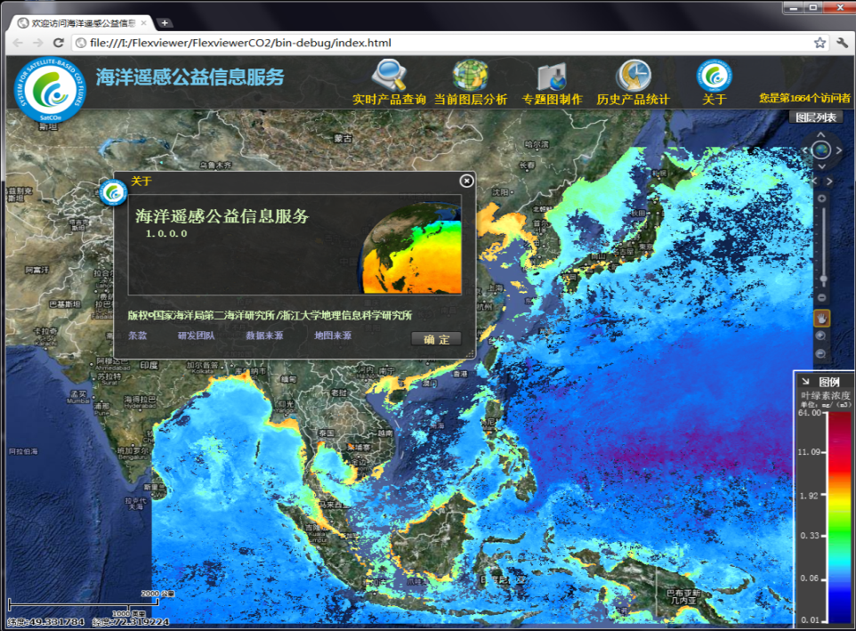
Information Systems of Ocean Satellite Monitoring for CO₂ Flux
（C/S version)
（B/S version）

Slide 18
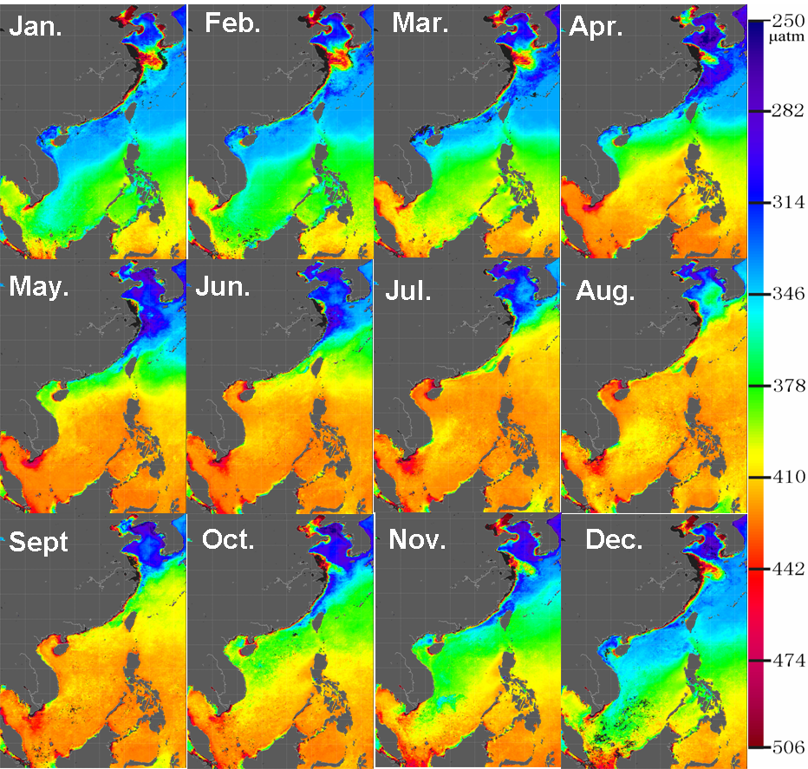
Satellite-derived monthly aquatic pCO₂ (2003-2009)
Bai et al., JGR-Oceans, 2015

Slide 19
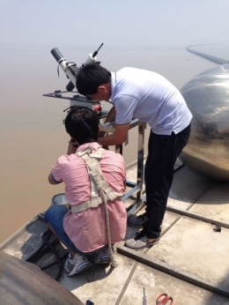
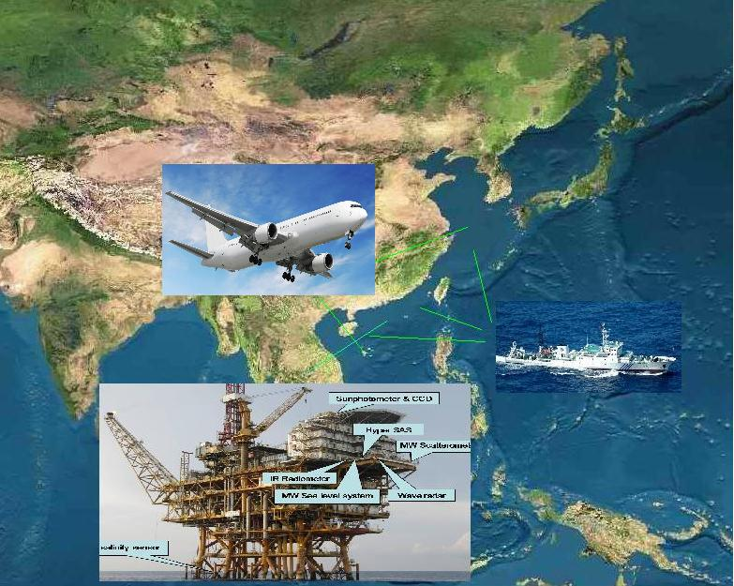
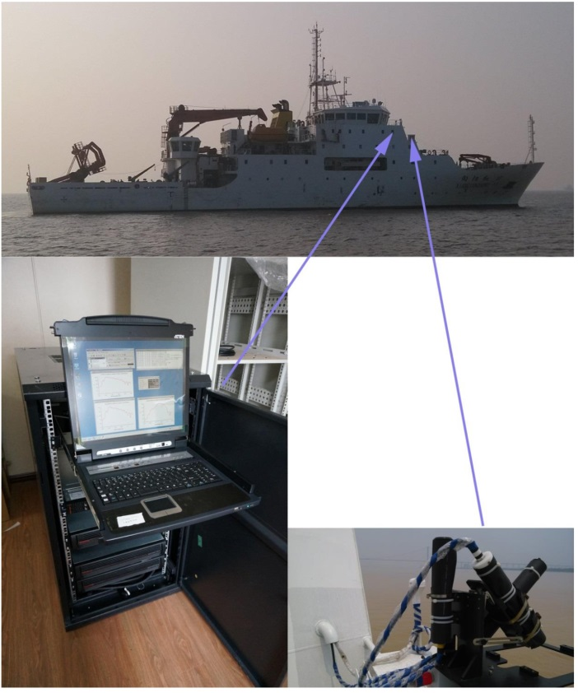
Cal/Val activity

Slide 20
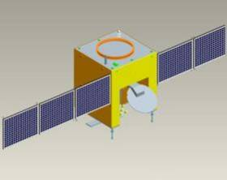
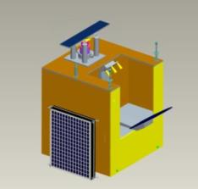
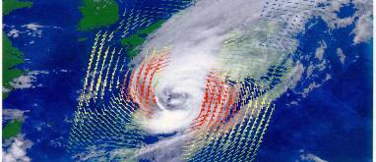
CFOSAT
Notes:
20

Slide 21
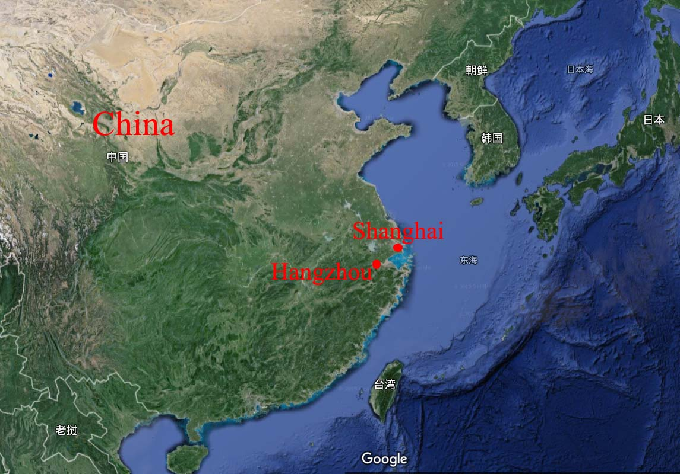
Welcome to Hangzhou, China
Thousand-Island Lake
Yellow mount
West lake

Slide 22
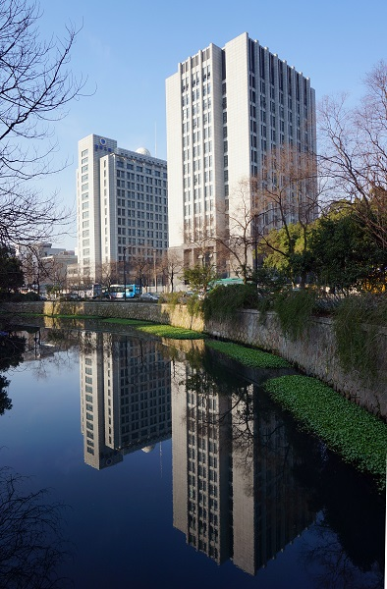
Thanks！

